Slide 1


AI
ASSGINMENT-2
Sonith(CS22B036) & Veerain(CS22B049)

Slide 2
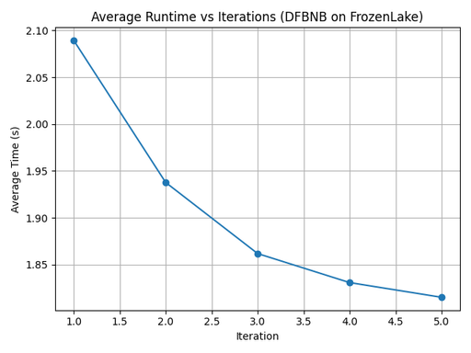
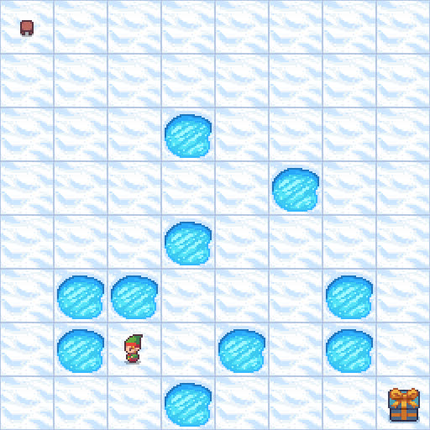
DFBNB ON FROZENLAKE – RESULTS & ANALYSIS
🎯 Heuristic Function
Reward-aware Manhattan Distance
Manhattan distance to goal.
Penalty for holes (+100), bonus for goal (-10).
Guides search efficiently by discouraging unsafe paths.
📊 Performance Metrics
Avg. Time Decrease:
Iteration 1: ~2.09s
Iteration 5: ~1.82s
Best Cost (U): Stable after early iterations.
🌀 Reason for Behavior
DFBnB is depth-first, exploring promising paths early.
Heuristic based so leaves those paths which have high U values
The Algorithm has been implemented to avoid holes by keeping cost to hole nodes as high (100)
Runtime drops as early iterations already reach optimal/better paths, reducing search effort later.

Slide 3
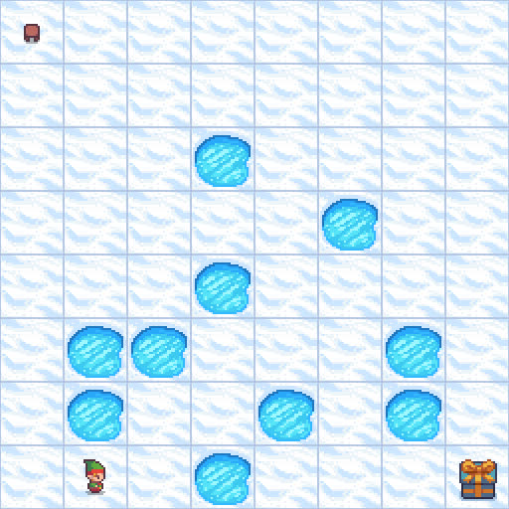
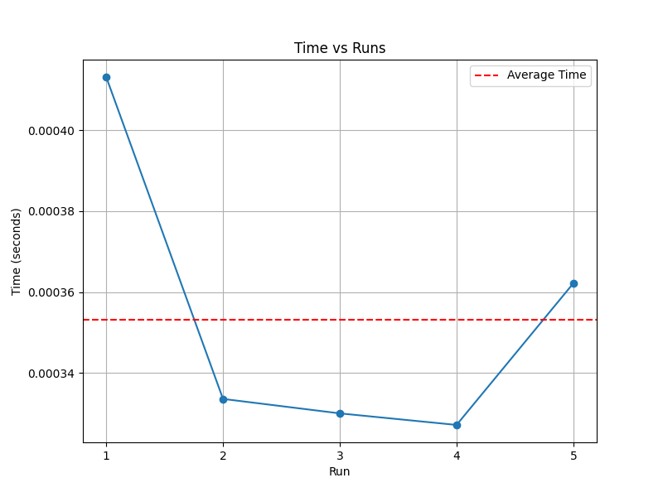
IDA*
Environment: Frozen Lake 8x8
Heuristic-Driven Search: Uses Manhattan distance to guide exploration efficiently towards the goal.
Iterative Deepening Mechanism: Combines depth-first search with cost-bound pruning, ensuring low memory usage and optimal path discovery.
Action Pruning Based on Grid Limits: Dynamically expands only valid actions based on the agent's current position in the grid.
State Reversion Logic: Maintains correct environment state by restoring previous positions, enabling consistent backtracking during recursion.

Slide 4
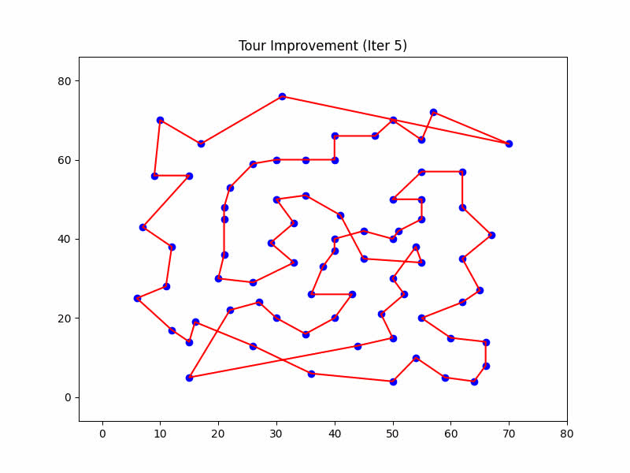
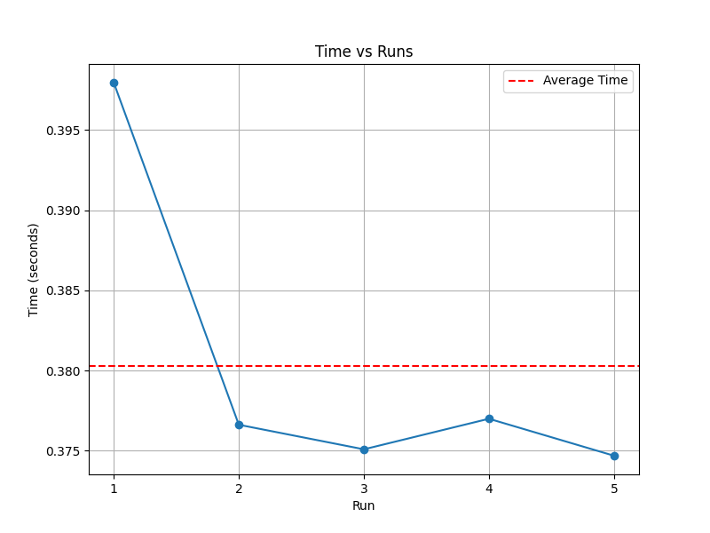
HILL CLIMBING
Environment: Traveling Salesman Problem
Start Tour: Constructed using a Greedy Nearest-Neighbor heuristic
Local Search: Applies 2-opt optimization to refine the tour iteratively
Reverses segments between two cities to reduce path length
Hill Climbing: Accepts only improving moves, stops when no better neighbour is found
Restarts: Repeats the process with different initial seeds to explore alternate solutions
Tour Evaluation: Uses Euclidean distance matrix to compute tour cost
Optimal cost: 538, Best path found: 570.106
Reason: It may be struct at the local Minima

Slide 5
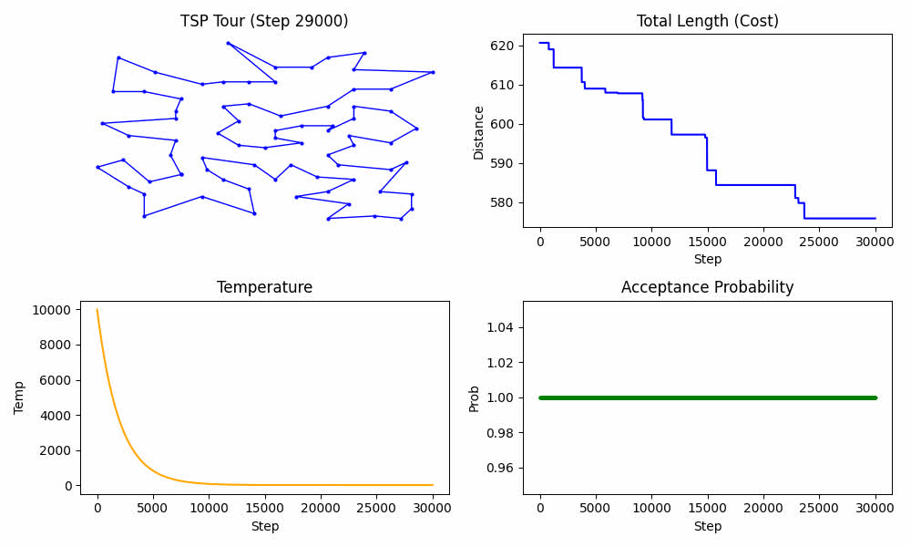
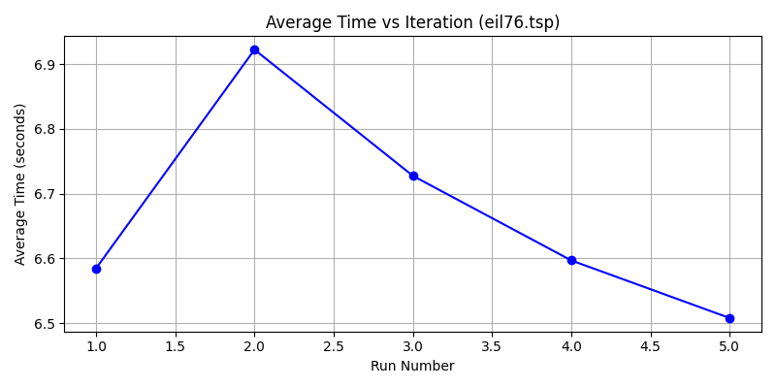
SIMULATED ANNEALING ON TSP – RESULTS & ANALYSIS
Heuristic & Candidate Generation
Objective: Minimize total tour distance (using Euclidean distance).
Heuristic: Evaluates cost via total_distance with three-opt moves to propose better tours.
Used Initialization with Christofides_tour (MST based Cyclic path) to get good kickstart
Cooling Schedule:
Initial Temperature: 10,000
Cooling Factor (α): 0.9995
Stop when temperature < 1E-4 or max time reached.
Performance Metrics & Behavior
Convergence:
Improvement is logged every 1000 iterations.
Gradual convergence toward lower-cost tours.
Exploration vs. Exploitation:
Early high temperatures allow for the acceptance of worse moves, escaping local minima.
Later, lower temperature leads to fine-tuning and exploitation.
Quality of Solutions:
Measured gap from best-known TSP solutions.
Visualized through periodic GIF snapshots capturing the evolving tour.
The optimal path is lower than the best path as it may have struck at local minima.

Slide 6
THANK YOU!

